Slide 1
3D Printed Astronomy
Liam Plybon
Darkstar Astronomical
International Dark Sky Association - East Texas Outreach Coordinator
lplybon1@gmail.com
liam@darkstarastronomical.xyz
Notes:
Howdy, my name is Liam Plybon, and I am the guy behind Darkstar Astronomical, a company that builds 3D printed tools and software for astronomers. Some of you already own things I have made, and I hope they are working out for you! Today I will be discussing the applications of 3D printing in astronomy. If there are any questions, don’t hesitate to ask! They spice things up nicely.

Slide 2
What is a 3D printer?
Able to operate in 3+ directions: x, y, and z
No need for clamps, workpiece holders, or other fixtures
Low waste.
Low energy.
No tool size constraints.
Excellent for small runs of parts.
Notes:
First, here is a broad definition of what a 3D printer is. They are an additive manufacturing process that operates in x, y, and z directions. Sometimes, they can operate in 4 or 5 dimensions by rotating the workpiece or tool head, but those are somewhat rare and are usually very expensive. 3D printers don’t have a need for workpiece holders, clamps and other fixtures. Instead, the workpiece is held by a scaffold that is printed at the same time as the part. This means you don’t really need any complicated setup for a print to start, unlike how other manufacturing methods may need chucks, clamps, or other fixtures.
3D printing is low waste. Well designed parts can have waste as low as a gram of plastic, which beats pretty much every other manufacturing method known to man. This is primarily due to it being an additive process rather than a subtractive process. Likewise, 3D printing can be fairly low energy. You can start a print and go to sleep, walk away, go to work, or whatever you may need to do. The printer only needs to be looked at when you are starting a part or ending a part.
Printers are not constrained by tool size. You can make your parts hollow, for example, with interconnected laticces all through the inside. The printer will not struggle with this. As a result, many of the parts printed with a 3d printer are impossible to replicate with other standard manufacturing methods.
Printers are great for small part runs, and producing parts only as needed. If you 3d print things, there is no need to build a warehouse of inventory; simply print a part when it is ordered and sell it.

Slide 3
What is a 3D printer?
What isn’t a 3D printer?
Able to operate in 3+ directions: x, y, and z
No need for clamps, workpiece holders, or other fixtures
Low waste.
Low energy.
No tool size constraints.
Excellent for small runs of parts.
Replacement for current technology.
End all - be all of manufacturing.
Jetsons food printer :)
Notes:
Here is what a printer is not. They are not a replacement for current manufacturing methods, because they suffer serious drawbacks that other methods don’t. Likewise, they are fairly slow and can’t crank out parts like injection molding can.
Printing isn’t the end all be all of manufacturing either. There will forever be facilities building cast iron parts, because that is the fastest and cheapest way to build something.
The Jetson’s food printer isn’t really feasible either. Printing takes time, and isn’t instantaneous. You trade speed for accuracy as well, so faster prints tend to come out a bit sloppy.

Slide 4
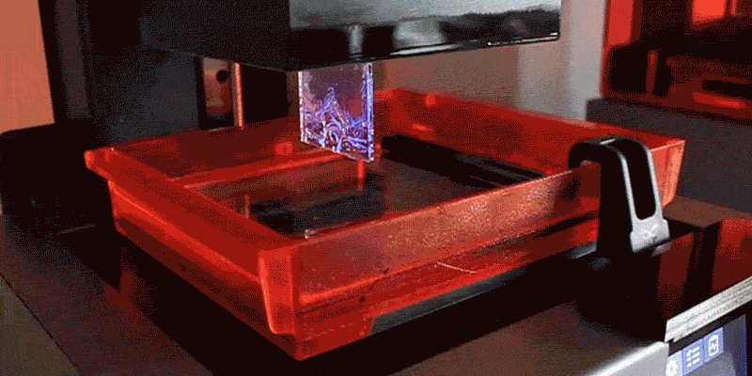
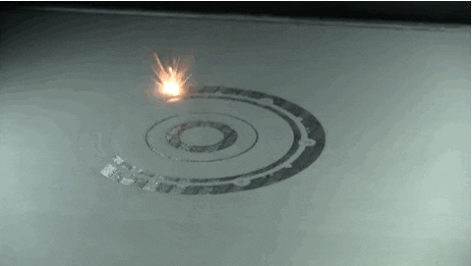
Types of Printers
Fused Deposition Modeling (FDM)
Stereolithography (SLA)
Selective Laser Sintering (SLS)
Notes:
Before I get into the astronomy, there is one last thing I want to talk about with printers themselves; that is the kinds of printers. There are FDM printers, SLA printers, and SLS printers. This will not be on the exam, but is still important.
FDM printers are like hot glue guns on xyz axis. They lay down a continuous bead of filament, depositing the material wherever it is needed. FDM machines can use a multitude of plastics, clays, cements, and even living cells, making them perfect for all kinds of unique engineering needs. For the home workshop, these are the most common type of 3D printer because they can work right out of the box, and only cost about 300 bucks.
SLA printers are a bit more advanced. Photo-active resin (similar to photo emulsion, for those of you who are used to film cameras!) is selectively hardened by a screen or laser in thin sheets, one after another. This looks like a finished part being pulled out of a puddle of resin, and is amazing to see firsthand. These machines are a bit more pricy, around 500 dollars, and the resin is pretty nasty stuff. These machines are typically not found in households, but some machines are available. SLA is far more accurate and precise then FDM, and is typically used for making figurines and sculptures, or parts with very tight tolerances.
Finally, laser sintering printers use a very high energy laser to melt a powder. Powder is brushed over the part layer by layer, and a laser melts metal where it is needed. These printers are rarely seen outside of advanced engineering labs and universities, but are slowly coming down in price. A new printer of this variety is around 20,000 dollars, and material is very hard to acquire. I will not be discussing metal printing in detail, simply because I have no experience with it.

Slide 5
Are astronomers using 3D Printers?
Notes:
So, do astronomers use 3D Printers? Well, I wouldn’t be here if the answer was no. Plenty of people are using 3D printing, from amateurs and professionals to manufacturers in the astronomy industry.

Slide 6
Printing in Industry
Baader Planetarium
Astro-Physics Inc.
Starizona
Agena Astro Products
And Countless Small Businesses
A short list.
Notes:
Here is a short list of companies using 3D printing to produce their components. Some companies do their printing in-house, while others send it out for manufacturing elsewhere. Most notably I think is the ‘small businesses’. It isn’t uncommon for single people to start their own companies 3d printing tools that they have designed. By my estimate, there may be hundreds of such companies in astronomy, producing parts that work for the telescopes that they own and want to help other people use. Most of these companies have only begun using 3D printed parts in the last 3 years. This may be the first time in a while that individuals on their own are adopting technologies *before* larger industries.

Slide 7
Things that can be easily printed
Housings
Holders
Covers
Caps
Dovetails
Bahtinov Masks
Adapters
Focusers
Pads & Bearings
Counterweights
Cases
Telescope Tubes
Truss Mounts
Gears
Belts
Setting Circles
Phone Brackets
Spacers
Eyepieces
Mirror Cells
Battery Boxes
Foucault Testers
Moon Maps
Knobs
Star Trackers
Pretty much anything else!
Notes:
As amateurs, what could we use printers for? Well as it turns out, just about anything. This is a list of different projects you can find on the Cloudy Nights DIY forum megathread for 3D printing. It isn’t a comprehensive list, either. This is from just 4 pages of the 50 page long thread.
People are printing their own telescopes and tracking mounts, casings and housings, and pretty much every other thing you could need. They may not be printing lenses or piers, but I even saw a printed roll off roof for a mini star tracker.

Slide 8
How do I use a 3D Printer?
Notes:
Here is the question I think most of you are asking right now. Of course, if you are not asking this question, then you are probably ready to leave!

Slide 9
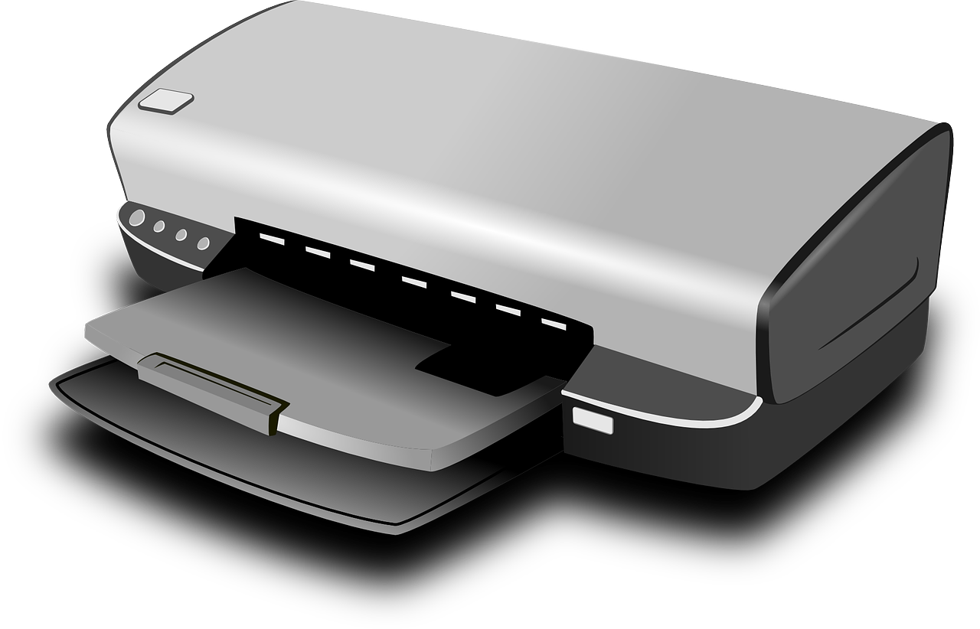
Getting a printer
Getting a cheap, reliable printer is the first step to getting a printed part of your own. For an FDM printer, look for:
Heated bed (60°C or greater)
Metal frame
20+ cm bed width
Cost ~$200 or more
If a printer fails to meet these specifications, don’t buy it!
I have had good success with the Ender 3 V2, CR-10, and Photon Zero (SLA!) printers.
Notes:
First, you need to get a printer. I recommend a middle-of-the-road FDM printer, so that you can quickly make plastic parts without fussing with the printer itself. Before getting one, check that it has a heated bed, metal frame, is able to print a medium sized object, and is around 200 or more in price. If a printer lacks a single one of these, it will cause more headaches than it solves. Cold beds will fail to hold a print securely, and plastic frames wiggle until the tolerance is terrible. Tiny printers are nearly worthless for practical use, and cheap printers have flaws you simply don’t know about until you try using them.
I listed a few of the printers I have used. The one I brought tonight is an Ender 3 V2 with about 100 dollars of upgrades including printed cable chains, a metal extruder, a steel nozzle, and a glass bed. I’ve had to replace a few parts, but it usually isn’t a big deal to do so.

Slide 10
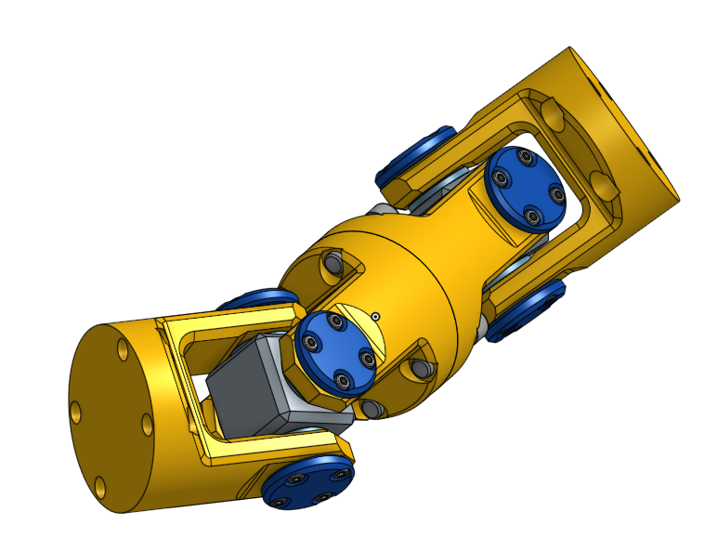
Getting a file
Pre-made files: (STL, 3MF, or STEP files are most common)
Yee olde Thingiverse.com (Biggest archive of designs available for free)
Printables.com (Posting your make can get you free, quality filament)
Just ask someone who might have it!
Make a file yourself: CAD (Computer Aided Design) tools can be used to create your own schematics.
Tinkercad: Free. Easy enough for kids to use, while retaining the important bits.
Onshape: Fairly powerful, but somewhat pricy. Student discount is free!
Fusion360: Free version of Autocad. Powerful, and has a CAM tool built in for CNC machining.
Autocad: Very expensive, but the most powerful design tool available today.
OpenSCAD: Free but esoteric. Parts are designed by writing a program, so it isn’t intuitive.
Get someone to make a file for you:
Upwork
Call me :)
Notes:
Once you have a printer, you need a file to print. This can be pretty easy! If what you want is common, or someone else has made it, you can usually find it online already. Thingiverse is the biggest repository of parts online, and has been in use for more than a decade. Unfortunately, the site is on hard times and is getting worse and worse. These days, the printing community is switching to Printables instead. The site has less parts than Thingiverse, but the search engine is far better and you can earn actual filament by just posting pictures of the things you print. I never complain about free stuff. Of course, if you see someone with a cool printed part you can ask them for the file too. Most people will offer it for free, while others may ask for payment.
If you can’t find a file anywhere, you can always make it yourself. CAD software has a bit of a learning curve, but once you know how to do it, you are set for life. Tinkercad is free and super easy for beginners. The software is made by the same company as Autocad, in preparation for kids going into the world as draftsmen. I have seen 10 year olds design and print their own hardware with it, so I am 100% confident that every person here could do it too. Onshape and Fusion360 are pretty similar in features, but I prefer onshape for now. I may switch to Fusion360 in the future. Autocad is the most powerful software on the market, but will cost a few thousand a year for the privilege to use. Student discounts may apply. OpenSCAD is free and open source, but is radically different in design. It will compile a program to generate a part, and is only recommended for people experienced with object-oriented programming.
Finally, you can always get someone to make a file for you. Websites for freelancers have plenty of draftsmen up for hire who will make a part for less than 50 bucks. For a somewhat shameless plug, you can also simply call me up, and I will help you make a part.

Slide 11
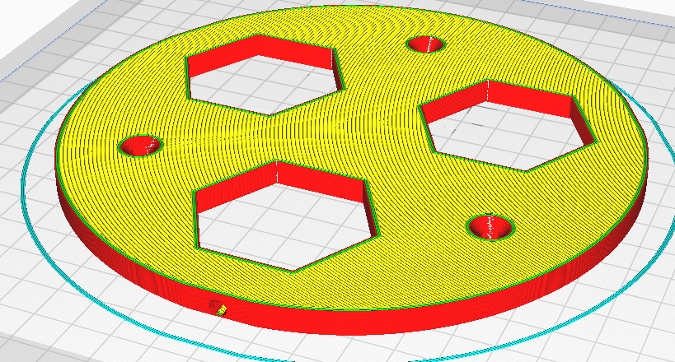
Slicing
Once you have a printer and file, you need to slice the model and start the print. Slicers take a solid model and create a GCODE file, which tells the printer how to move and what temperatures to hit.
Most printers come with their own slicer, but you can also download and use ones from the internet for free.
Ultimaker Cura: Free, open source, and lots of features. Simple interface removes clutter and makes slicing easy. I recommend this the most.
Octoprint, Slic3r, Slicer, Repetier, and PrusaSlicer are all good as well.
Ensure that the slicer settings match your printer before generating the file.
Notes:
Before the hotend will warm up, you need to slice the model. This converts the model mesh into a list of positions, temperatures, and speeds that the printer will understand. Here, you decide how dense you want the part to be, how fast the printer runs, and how thick the layers and shells of the print will be. The slicer will output a GCODE file, which is actually human-readable. Anyone here with a background in machining and CNC should be able to read printer GCODE just as they would CNC GCODE: its the same thing!
I recommend using Ultimaker Cura. The software is free and super easy to use, and runs on just about any computer. Other programs may have more or less features, like running a print server, running printers remotely, and even live feed cameras to watch the printers work. This complexity can wait until you have made a few prints of your own.

Slide 12
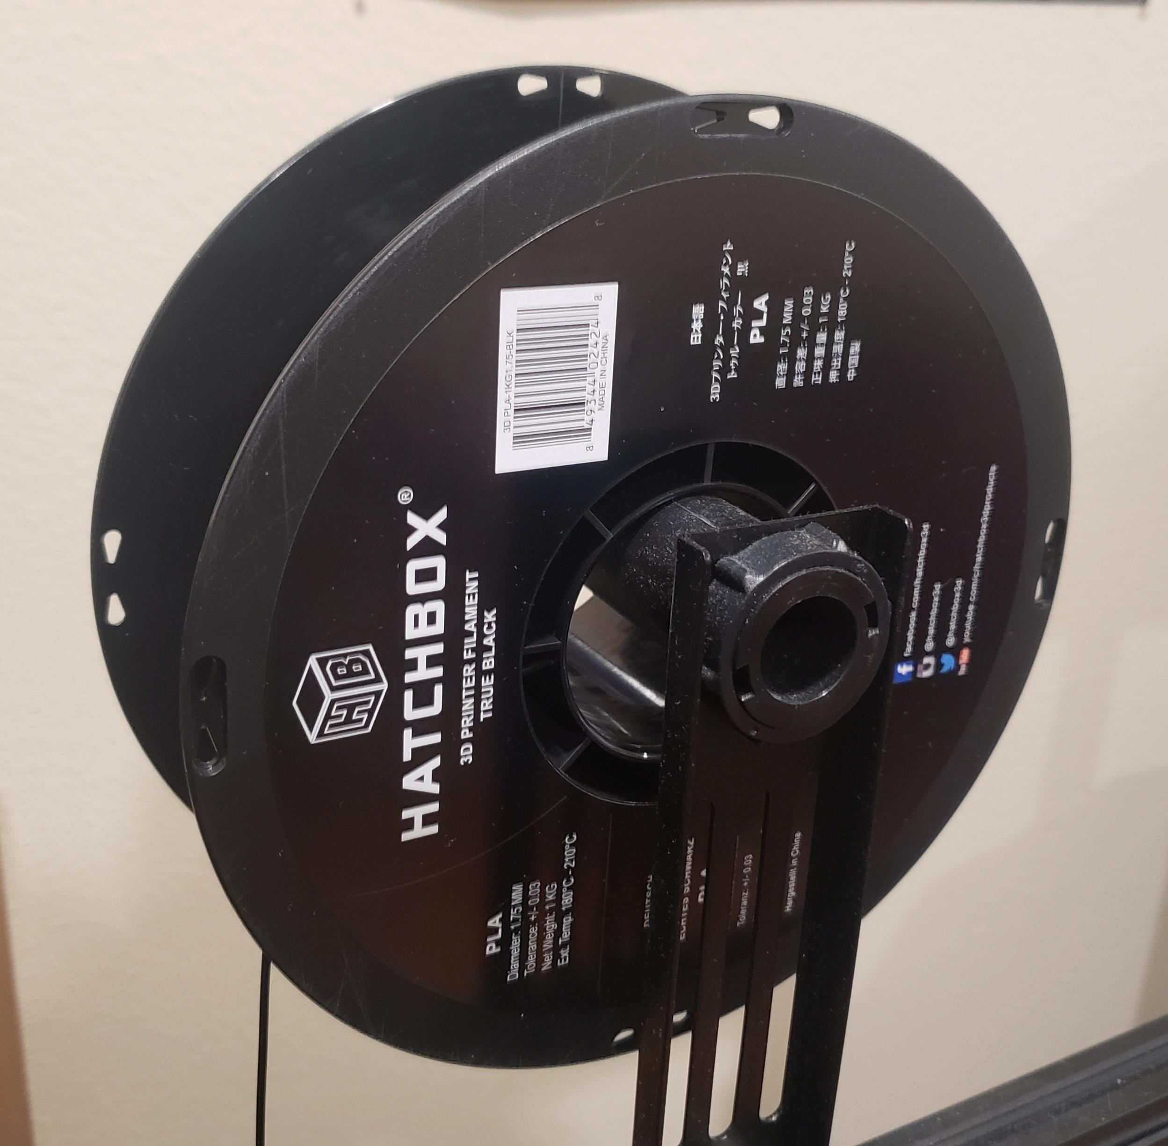
Materials
Commercial: Cheap and works out of the box
PLA (PolyLactic Acid)- Biodegradable after several years, low melting point, easy to print. Perfect for beginners.
ABS - Hard, smelly, and non-biodegradable with a higher melting point. No longer as common as it used to be.
PETG - Standard filament for outdoors use. Hard, slightly high melting point, no fumes, chemical resistant.
TPU - Flexible material with great chemical resistance. Similar print difficulty to PETG.
Engineering: Expensive and a real pain
Carbon Fiber Reinforced - Extremely hard and lightweight, perfect for advanced uses. Requires a steel nozzle, and high temperatures w/ enclosure.
Metal Filament - 90% metal, can be printed and sintered in a kiln to produce a full metal part. Requires a kiln to sinter the part, and a very rigorous printer.
Notes:
As for the materials you might use, there are all kinds of options. In the old days, weedeater cord was the default material; as a result, filaments are usually sold in 1.75mm diameter. But, for a typical FDM printer today, while plastics are the go-to, they are not all that is available.
Filaments can be broken down into ‘commercial’ and ‘engineering’ grades. Commercial filaments are designed to work immediately with minimal tinkering and frustration for amateur printers. They are by and large thermoplastics with low melting points. PLA, or Polylactic Acid, is the most common plastic in use today. It is a biothermoplastic made of corn, which makes me feel a little better when I use it. In fact, you can feed it to Oyster mushrooms and make lunch with it. ABS is the old standard filament, but it makes a lot of fumes, warps strongly, and needs high temperatures. I no longer recommend it. PETG, or Polyethylene terephthalate glycol, is the best of both. The material behaves similarly to Teflon, making it excellent for bearings and other sliding surfaces, and is very hard. At the same time, it has similar printability to PLA, making it the optimal filament for outdoors gear. As astronomers who use gear outside, this is the best filament for us. I also want to mention TPU, or Thermoplastic polyurethane, for it’s great material properties. TPU is commonly used to make the rubbery parts of phone cases, and works great for anything that needs flexibility. Unfortunately, TPU has to be printed slowly to prevent printing errors.
Engineering filaments are for people who run industrial printers, although with a few modifications most commercial printers will be able to print them as well. These filaments can be nearly a hundred dollars per kilogram, however, so you will not be buying them on a whim. Carbon Fiber reinforced filaments are designed to provide the hardest and lightest plastic parts available, with good material properties. At the same time, it will abrade and destroy nozzles quickly. Metal filaments allow you to print a solid metal part with materials ranging from inconel and titanium to bronze and silicon carbide. The metals are mixed with PLA, so that you can print a part and fire it in a kiln to burn off the plastic and sinter the metal.
For us, sticking with commercial filaments is the way to go. Now, you have a printer, a sliced file, and some filament. All that is left is printing!

Slide 13
CLICK PRINT
Notes:
Printing is *usually* the easy part. In reality, there are plenty of things that can go wrong even when you have completed everything up until now. In reality, this is what will happen the first few times you try and print something.

Slide 14
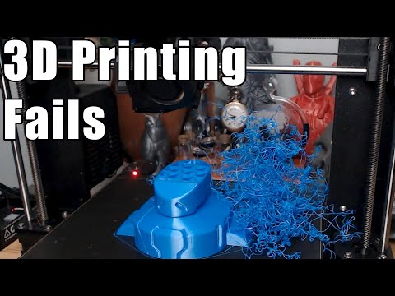
What will probably happen:
Notes:
Here’s a fun video of some failed prints to show you what I mean. Let’s take a watch; I’m speeding it up to 2x speed because I am an impatient man.

Slide 15
Issues
Solutions
Bed Adhesion
Stringing
Clogged Nozzle
Loose Belts
Filament Jam
Dead Heating Element
Pillowing
Delamination
Warping
Underextrusion
Spontaneous Power Outage
Spaghettification (not the cool black hole kind!)
Adhesive | Increase Bed Temp
Cool Nozzle | Retraction
Clear Clog w/ Needle
Tighten Belts
Cold Pull | New Filament
Replace Heating Element
Increase Infil %
Relevel/Clean/Adhesive on Bed
Reduce Cooling Fan Power
Set Extrusion to 105%
Don’t Print During Storms
Slow Print Down
Notes:
Don’t let this scare you, either. 3D printing is a very popular hobby, so there are resources all over the web documenting what your print issues are and how to resolve them. One important thing is simply knowing the name of what to look for, or taking a picture of the problem itself. You can post problems to the 3D printing subreddit, various facebook groups, and anyone else that might have a printer of their own. I included this list simply to give you a taste of the 3D printing lingo, not so that you would be able to diagnose and fix print issues right away.

Slide 16
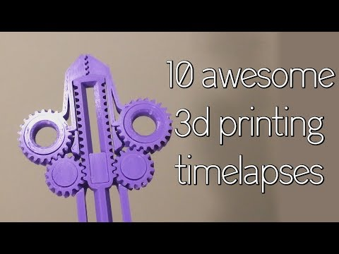
All issues fixed? Get ready for hypnotic prints.
Notes:
Once you have all of your issues fixed, all you can do is sit and watch. This is a timelapse of some 3d prints from 2018, and the quality difference between printed parts then and now is actually somewhat obvious. Notice the strings hanging off of their printed parts; you don’t see that on the stuff I brought in today.

Slide 17
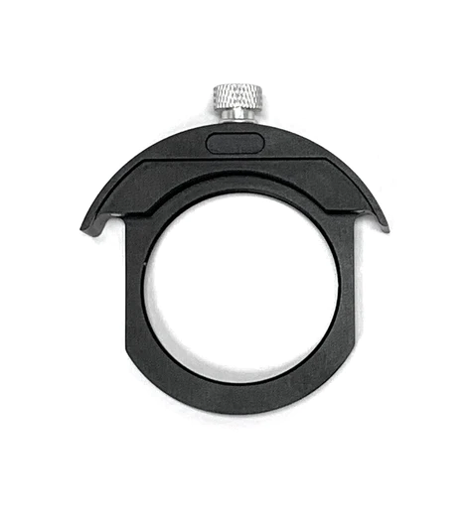
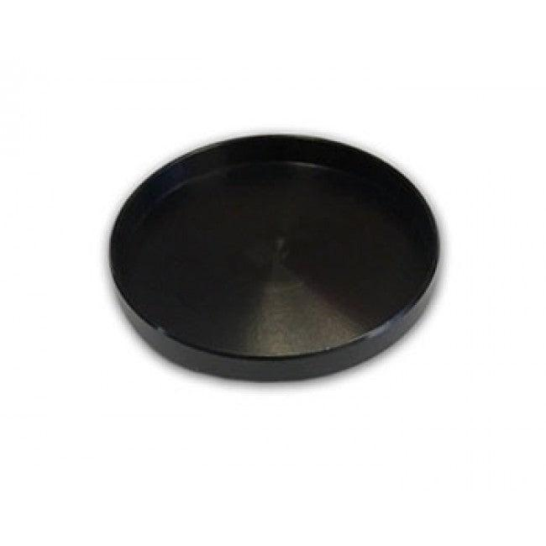
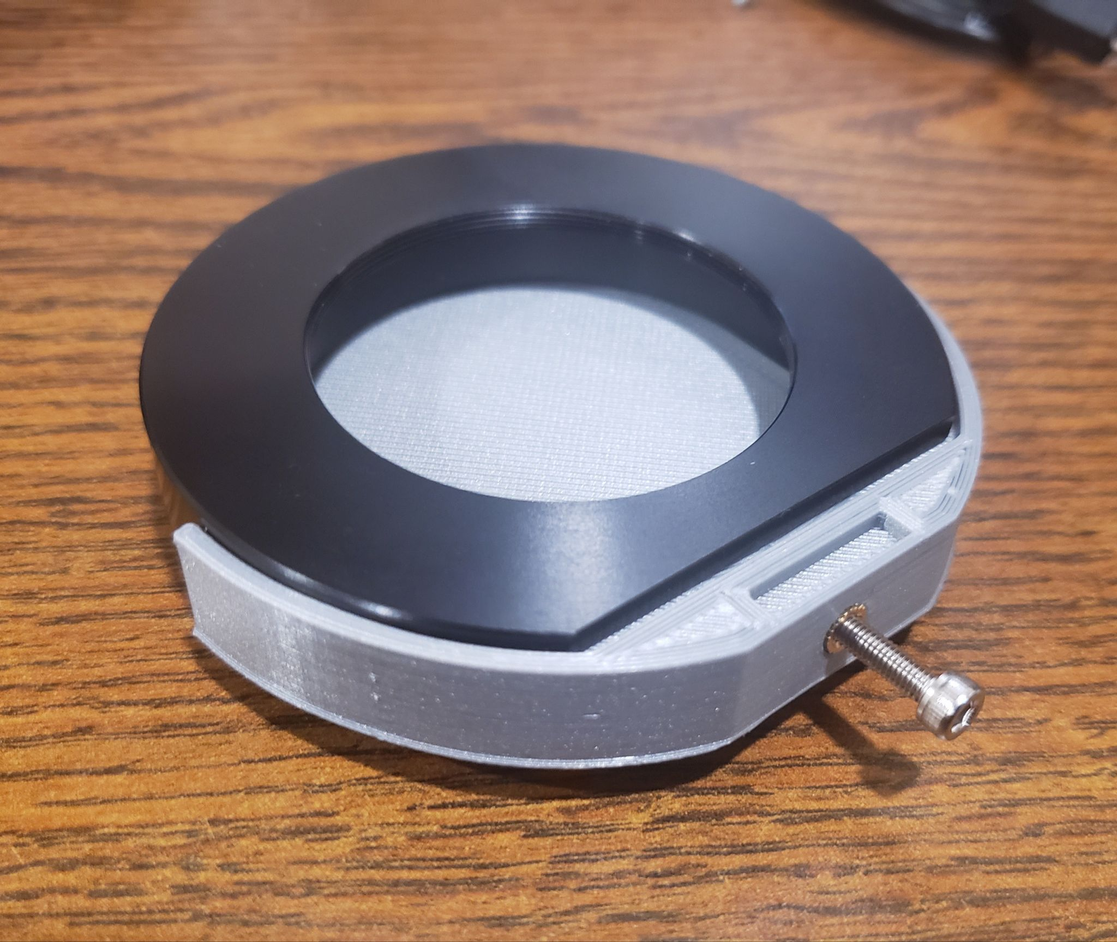
Gallery
+
=
$ 2 $ 25 $ 20
Notes:
To finish up the talk, here are some things I have printed myself to give you ideas. Most of the parts you need can be printed for far cheaper than bought. For example, this dark filter I printed costs me about 2 dollars to make, while a comparable setup from the manufacturer costs nearly 50 dollars. Mine fits a little better, too, and the handle is longer for comfort.

Slide 18
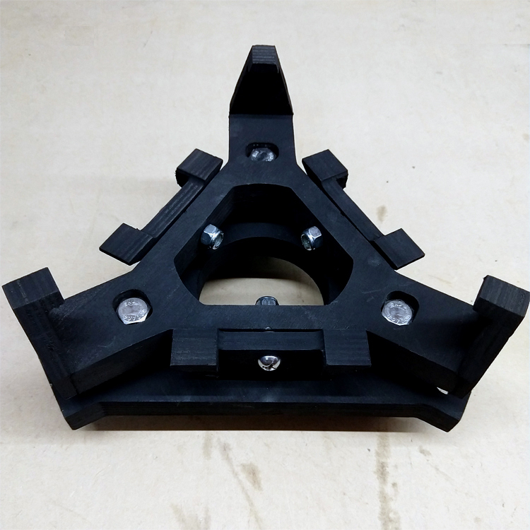
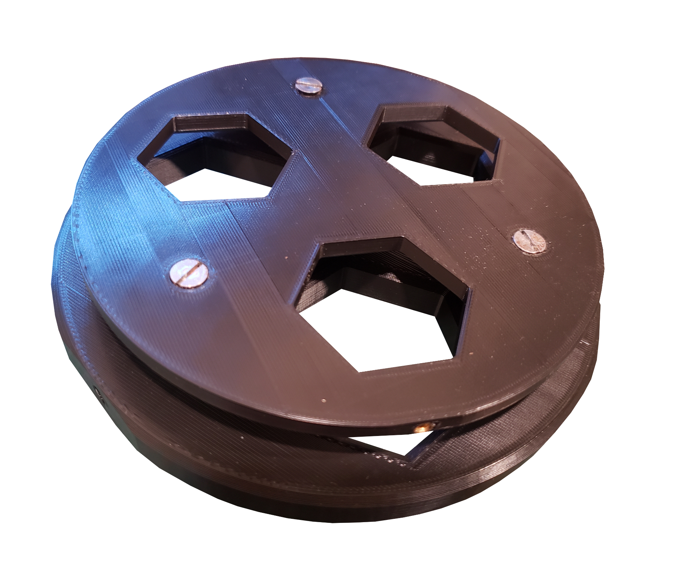
Gallery
=
$ 5 $ 50
Notes:
Likewise, this is a 3D printed mirror cell for a 6 inch mirror. I designed and printed it in about 2 hours (plus 2 days for a good print) and spent about 5 dollars on the parts. On the other hand, a metal mirror cell would cost me about 50 and would be 5 times heavier for the same strength.

Slide 19
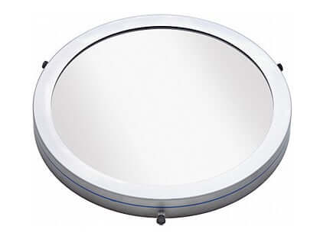
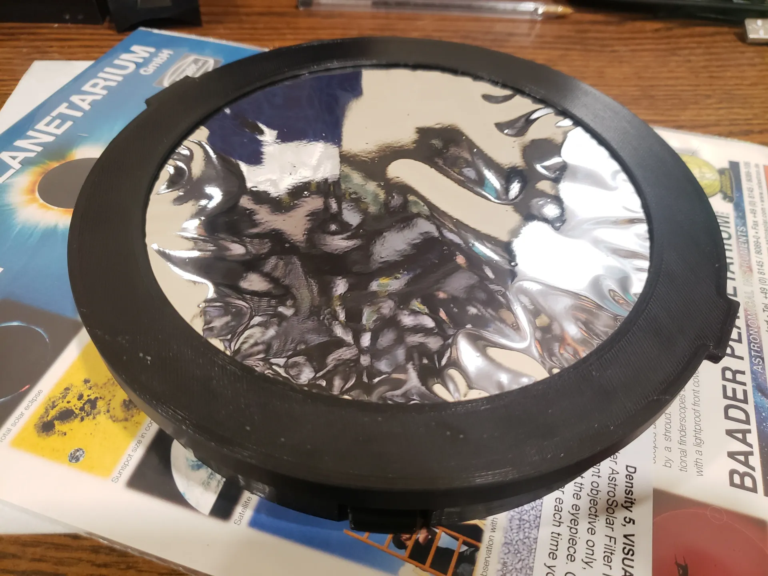
Gallery
+
=
$ 20 $ 125
Notes:
Finally, here is a solar filter I printed for my dobsonian. Unlike a store bought one, this filter fits into the same slots used by the tube cap. This means it has no lip that can be knocked off, and it can’t catch the wind and blow away while observing. It has no screws that might scratch the paint on the telescope tube, either. Most importantly, saved me a hundred dollars. Most of the cost was simply buying the solar safety film.

Slide 20
Sources
FDM Robot Gif: Robot 3D print timelapse on RepRapPro Fisher.webm:, CC BY 2.5, https://commons.wikimedia.org/w/index.php?curid=71058809
SLA Printer Gif: https://giphy.com/gifs/3d-printing-HkLlFZClCU7bW
Laser Sintering Gif: https://giphy.com/gifs/ge-3d-printing-aviation-jet-engine-s4gruPYPsSrmg
Starizona Filter Drawer & Dark Filter: www.starizona.com
Birch Mirror Cell: www.astrogoods.com
Orion Solar Filter: www.telescope.com
Notes:
I hope this talk has been useful! Now, I will be answering questions about the printer.

Slide 21
Questions?

